Slide 1

Driver Drowsiness
Detection
System
———— ————

Slide 2
G. V. Otari
Assistant Professor
Department of CSE, KIT.
Project Guide
Team Members
1718000226
Revati Patil
Welcome
1718000227
Ruchita Patil
1819010035
Suhasini Sonavane
1819010037
Supriya Yadav
2

Slide 3

Agenda
Introduction
Objective
Problem Statement
System Workflow
Proposed Work
Architecture
Dataflow Diagram (DFD)
Implementation
Testing
Snapshot
Applications
Advantages
Conclusion
Limitations
Future Enhancements
References
3

Slide 4
Introduction
According to the latest reports by NHTSA, approximately 697 number of deaths occurred due to drowsy driving out of total fatalities in 2019.
The purpose of Driver Drowsiness Detection System (DDDS) project is to provide a real- time monitoring system using video processing, face/eye detection techniques.
This system deals with automatic driver drowsiness detection based on visual information.
4

Slide 5


Objective
Avoid Accident
Keeps the Driver Focused on road
5

Slide 6


Problem Statement
Drowsy driving = Driving + Sleepiness
Drowsy driving causes accident
Causes of drowsiness
→Lifestyle factors
→Mental state
→Medical conditions
→Medications
→Sleeping disorder etc…
6

Slide 7
System Workflow
Image will be captured by a camera installed in front of the driver
Expressions of the face are read.
Eyes and mouth are especially detected for the drowsiness.
Classify the eyes and mouth into either open or closed.
The time duration of the eyes closed and mouth open is calculated to predict the drowsiness of the driver.
Based on result, alert will be given
7

Slide 8


Proposed Work
In this model, the person's face is filmed by a camera in the first step by receiving 30fps video sequence.
Now, in the received frame from captured image we use detection of face eyes and mouth and apply behavioral measures such as eye closure and yawning to detect drowsiness of the driver.
8

Slide 9
Architecture
F
R
A
M
E
Eye Condition
A
L
A
R
M
Segmentation of Face
User
Webcam
Yawning
Detection
9
Fig1. Architecture of Drowsiness Detection system

Slide 10
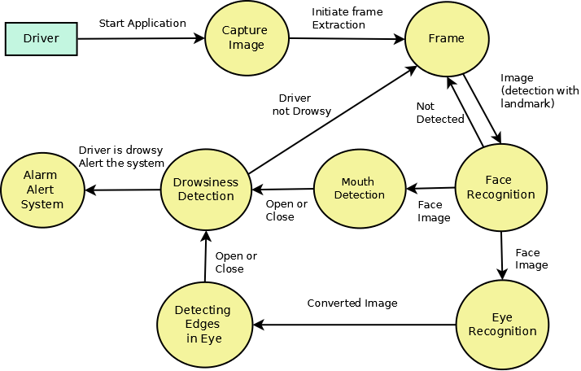
Data Flow Diagram
10
Fig2. Data flow Diagram

Slide 11

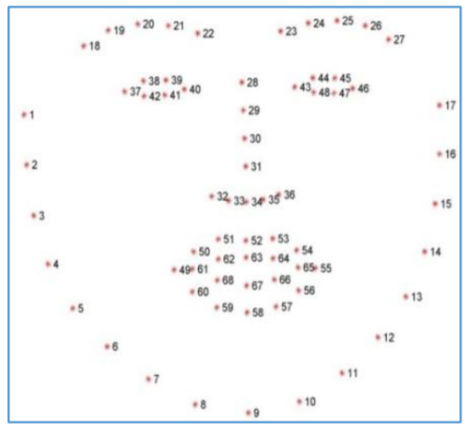
Implementation
Segmentation of Face
Facial Landmarking
11

Slide 12

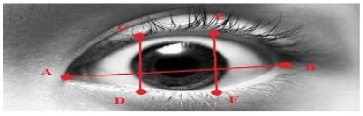
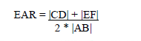
Implementation
Detection of eyes and its condition
1.Eyes are detected
2. Eyes are segmented from the face
3.EAR(Eye Aspect Ratio) is computed
12

Slide 13

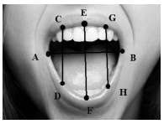
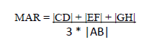
Implementation
Detection of mouth and its conditions
1.Mouth is detected
2.MAR(Mouth Aspect Ratio) is computed
13

Slide 14
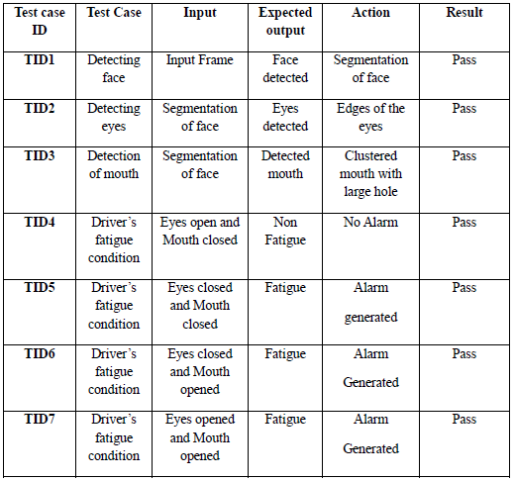
Testing
14

Slide 15
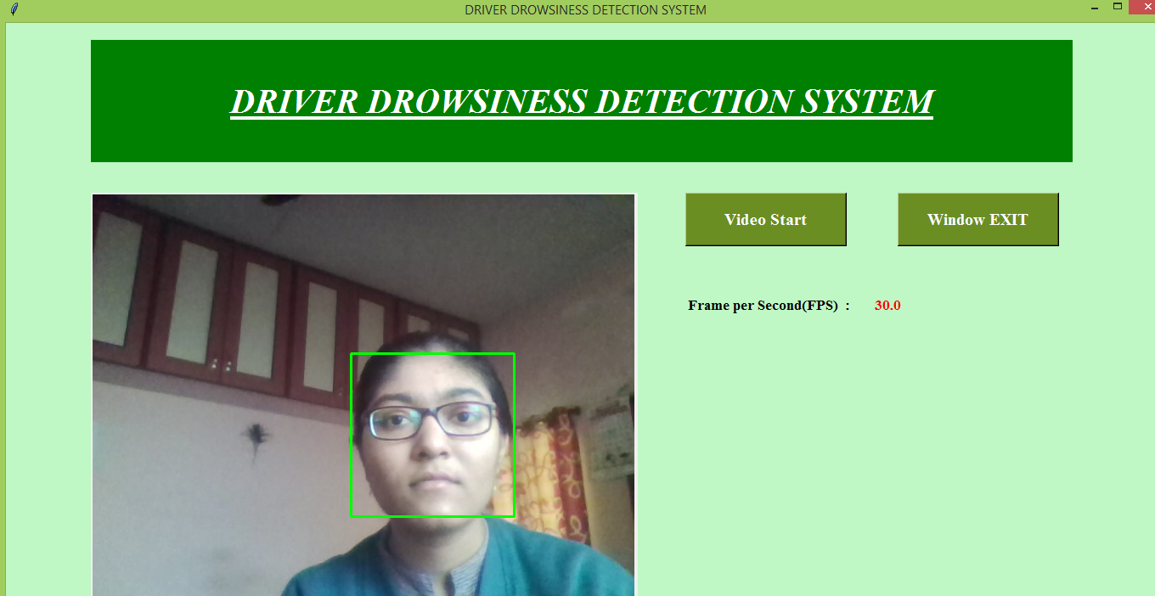
Snapshot
Face Detection
15

Slide 16
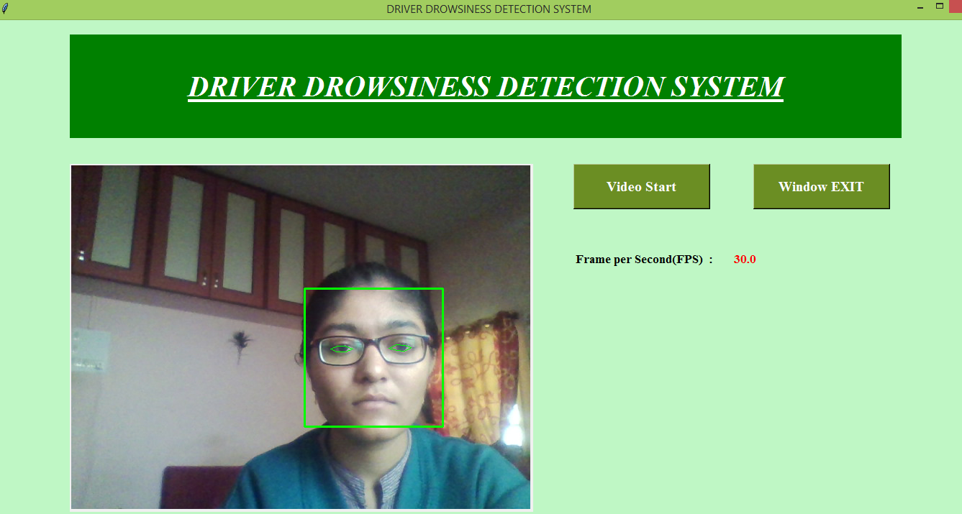
Snapshot
Eye Detection
16

Slide 17
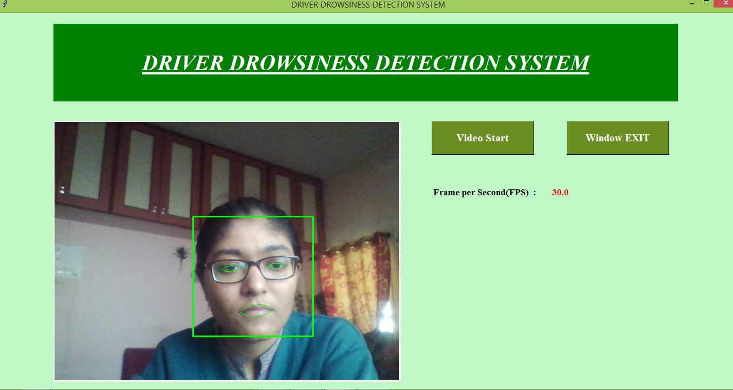
Snapshot
Mouth Detection
17

Slide 18
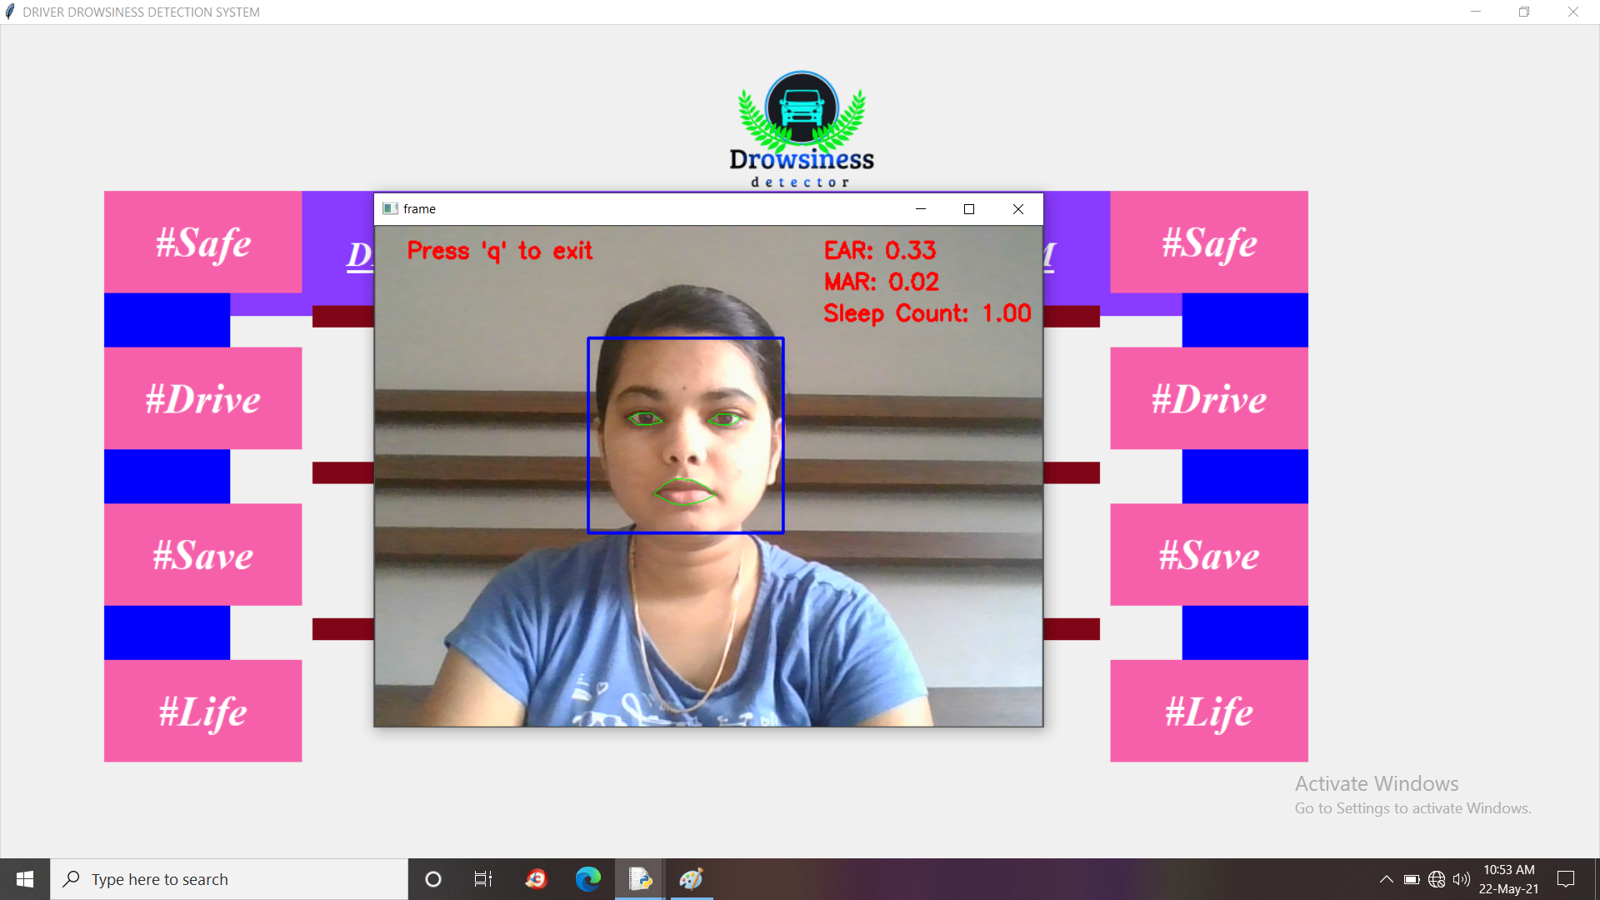
Snapshot
Eyes open and Mouth closed - When EAR value is greater than 0.30 – SAFE DRIVE
18

Slide 19
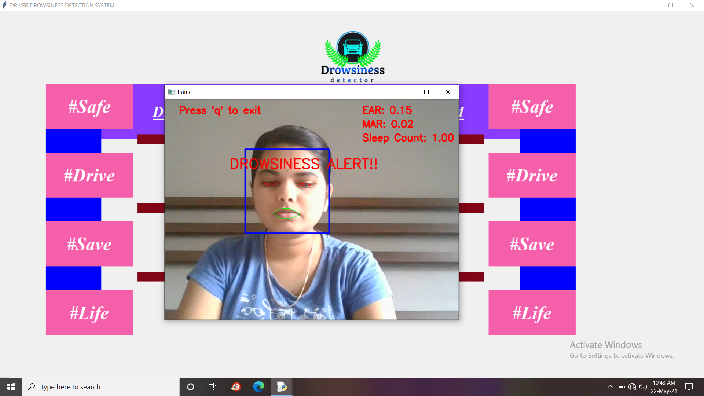
Snapshot
Eyes closed and Mouth closed - DRAWSINESS DETECTED - EAR value is less than 0.30
19

Slide 20

Snapshot
Eyes closed and Mouth opened - DRAWSINESS DETECTED - EAR value is less than 0.30 and MAR value is greater than 0.6
20

Slide 21
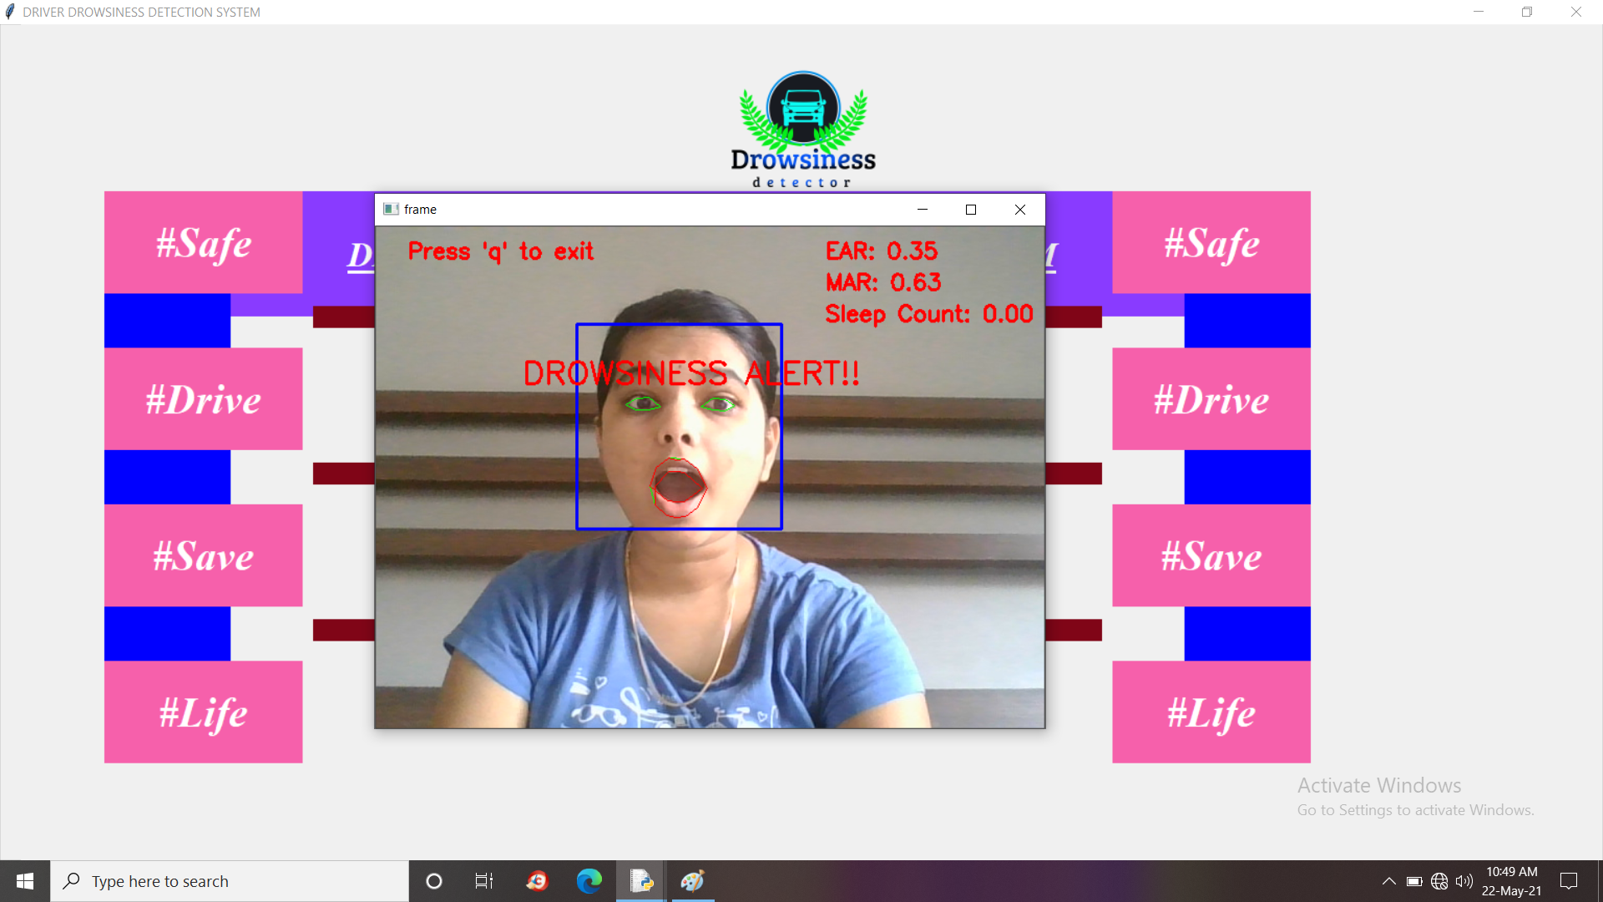
Snapshot
Eyes opened and Mouth opened - DRAWSINESS DETECTED - EAR value is greater than 0.30 and MAR value is also greater than 0.6
21

Slide 22




Application
Prevents the driver from falling asleep in long and solo trip.
System can also be used in other situation such as :
pilots of
airplanes
Operator at
nuclear
power plant
Transportation
business
Security guard
cabin
22

Slide 23



Advantages
By detecting abnormal behavior, life of the driver can be saved by alerting him using the alarm system.
Accidents will be reduced.
Cost of the system is Low.
23

Slide 24
Conclusion
The system monitors and detects the loss of attention of drivers.
The proposed approach will use Eye Aspect Ratio and Mouth Aspect Ratio with adaptive thresholding to detect driver’s drowsiness in real-time and the life of the driver can be saved.
24

Slide 25
Limitations
Accuracy compromised in low light conditions.
Sunglasses are distraction factor to check drowsiness.
25

Slide 26
Future Enhancements
Ultrasonic sensors are connected on the left and behind the car to detect the distance between the car and the road side and to detect any other car behind, With that we can reduce the chances of accident .
Efficiency can be improved by using infra red camera in low light conditions.
System in near by proximity can interact to send signals to other driver in case any driver is in drowsy mode.
26

Slide 27
References
Sukrit Mehta, Sharad Dadhich, Sahil Gumber, Arpita Jadhav Bhatt, “Real-Time Driver Drowsiness Detection System Using Eye Aspect Ratio and Eye Closure Ratio”, Peer review under responsibility of International Conference on Sustainable Computing in Science, Technology and Management
Ashlesha Singh, Chandrakant Chandewar and Pranav Pattarkine, “Driver Drowsiness Alert System with Effective Feature Extraction”, INTERNATIONAL JOURNAL FOR RESEARCH IN EMERGING SCIENCE AND TECHNOLOGY, VOLUME-5, ISSUE-4, APR-2018
Isha Gupta, Novesh Garg, Apoorva Aggarwal, Nitin Nepalia and Bindu Verma, “Real-Time Driver’s Drowsiness Monitoring Based on Dynamically Varying Threshold”, Proceedings of 2018 Eleventh International Conference on Contemporary Computing (IC3), 2-4 August, 2018, Noida, India
Maganti Manasa, Vikas B, K. Subhadra, “Drowsiness detection using Eye-Blink frequency and Yawn count for Driver Alert”, International Journal of Innovative Technology and Exploring Engineering (IJITEE),ISSN: 2278-3075, Volume-9 Issue-2S3, December 2019
K .H. Wanjale, Amit Bhoomkar, Ajay Kulkarni, Somnath Gosavi, “Use Of Haar Cascade Classifier For Face Tracking System In Real Time Video”, International Journal of Engineering Research & Technology (IJERT),Vol. 2 Issue 4, April – 2013, ISSN: 2278-0181
27

Slide 28

28

